Slide 1
Refining static analyses with hints
Francesco Logozzo
Vincent Laviron

Slide 2
Abstract interpretations
Three elements
Abstract elements
Belong to a (possible infinite) set A
Which properties can be expressed?
Domain operations
⋄ ∈ [A^{n} → A]
Ex. Join, meet, widening, narrowing …
Transfer functions (semantics)
t ∈ [Stm x A → A]
Ex. Assign(x = y + 2, [y → [2,3])

Slide 3
(1.) Abstract elements
if(...) x =-1;
else x = 1;
assert x ≠ 0;
No convex domain do the work
Problem:
The abstract elements are not expressive enough
Many, many works to overcome the problem
I will not talk about it here today…

Slide 4
(3.) Transfer functions
Ex. With Octagons (± x ± y ≤ k) :
Assign(x = y + z, [z ≥ 0]) = [z ≥ 0]
Refined by
Assign*(x = y + z, [z ≥ 0]) = [z ≥ 0, x ≥ y]
Many, many papers on that …
I will not talk about it here today…

Slide 5
(2.) Domain Operations
Join, widening, meet …
Intervals
0 ≤ x ∧ 0 ≤ y
Octagons
0 ≤ x ∧ 0 ≤ y ∧ x ≤ y
Polyhedra
0 ≤ x ∧ 0 ≤ y ∧ y ≤ 100⋅ x
What ????
void Loop() {
int x = 0, y = 0;
while (...) {
if (...)
{ x++; y += 100; }
else if (...)
if (x >= 4)
{ x++; y++; }
}
assert x <= y;
assert y <= 100 * x;
}

Slide 6
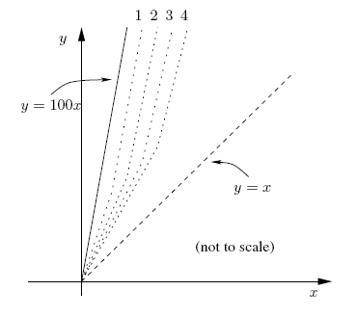
????
The killer is the widening
The widening for Octagons tries to infer a bound for
x – y ≤ k
The widening for Polyhedra

Slide 7
Refining the widening ?
Observation: x ≤ y is a programmer annotation
The analysis should keep this information
Refine the widening to extrapolate this bound
Example of syntactic hint
What if the assertion was x ≥ 10 ⇒ y ≥ 5 ?
Observation: Poly can be made as precise as Octagons
Seek an interval for the expression x – y
[0, 0] in the example
Example of semantic hint

Slide 8
In a perfect world
Widening is the only (standard) domain operation to lose precision
Galois connections-based Abstract Interpretation
C: Concrete domain, complete lattice
A: Abstract domain, complete lattice
Soundness relation given by α, γ :
Join is optimal

Slide 9


In a less perfect world (reality)
Most analyses do not have the best approximation
Ex. no best polyhedron for
Weaker form of abstract interpretation
Abstract domain: pre-order
Only concretization γ (no α) :
Consequence:
Join is not optimal (so meet, …)

Slide 10
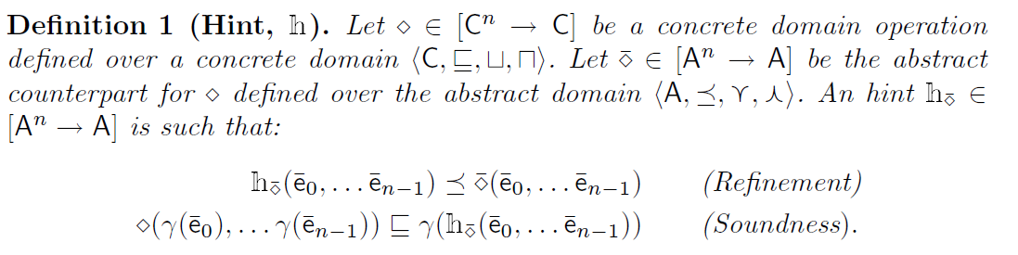
Hints
Systematically refine abstract operations
Useful when
The abstract domain can express a better result
The abstract operation fails to determine it

Slide 11
Properties …
Identity is a hint ☺
Composition of hints is a hint
Can be designed modularly
An abstract semantics with hints is still sound
Replace each ⋄ with 𝕙(⋄)
𝕙(∇) may not be a widening
Convergence not assured
…

Slide 12
Syntactic hints: User provided
User annotations are gold:
Fight hard before giving up!
In the example: x <= y ∊ pred(Loop)
Refine the widening for Polyhedra
Prove the assertion
Clousot: Used by Subpolyhedra

Slide 13
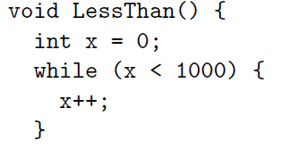
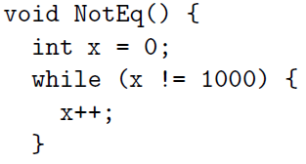
Syntactic hints: Thresholds
Widening infers x ∊ [0, +∞]
Narrowing refines to x ∊ [0, 1000]
Widening infers x ∊ [0, +∞]
Narrowing fails to refine x

Slide 14
Syntactic hints: Thresholds
Refine widening with thresholds
Standard:
Given a set T of numbers
Clousot
T = { k, k + 1, k-1 | k is a constant in a method }
T is method specific

Slide 15
Semantic hints: Saturation
Abstract domains can be composed A₁ x A₂ … x A_{n}
Operations are point-wise defined
May lose cross-relations
Saturation hint
Saturate the arguments
Propagate the constraints
Apply the operation pair-wise
Example
No saturation: (x ≤ 0, y ≥ 1; _) ⊔ (_, x < y) = (_,_)
Saturation: (x ≤ 0; y ≥ 1; x < y) ⊔ (_, x < y) = (_, x<y)

Slide 16
Semantic hints: Die-hard
Saturation is too expensive
Observation: Most of the constraints one wants to keep are already explicit in one operand
Ex: (x ≤ 0, y ≥ 1; _) ⊔ (_, x < y)
Three steps:
Pair-wise join
Collect the dropped constraints
Check if implied by the other operand
Clousot: Used by Pentagons, Subpolyhedra, …
Avoid the use of an explicit saturation

Slide 17
Semantic hints: Template
Bound linear forms:
If P = { ± x ± y } then Octagons
Useful to give lower bounds to precisions
Idea similar to template constraint matrices
Just faster in general
No need to solve 2n LP problems

Slide 18
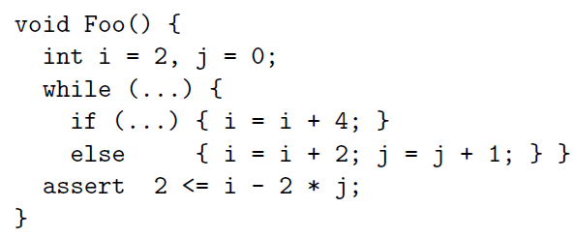
Semantic hints: 2D Convex Hull
Compute the 2D hull of the operands
2D Hull faster than general
Clousot with Subpolyhedra:
Prove all the examples of CH78 paper

Slide 19
Semantic hints: Reductive
Example: Abstract compilation of
b1 == b2 && b2 == b3
Corresponding operator
ϱ =λe. e[b1,b2→ e(b1)⋀ e(b2)]⋀b[b1,b2→e(b2)⋀e(b3)]
ϱ¹(e[b3→ true]) = e[b2,b3→ true]
ϱ²(e[b3→ true]) = e[b1,b2,b3→ true]
Observation:
Iteration improves the precision of operations

Slide 20
Reductive hints
Simple iteration is unsound
Ex. Unary minus
Need hypotheses on the concrete counter-part
Closing function: reductive and idempotent

Slide 21
Conclusions
Hints help improving the precision of analyses
Orthogonal to abstract domain operations
Very helpful in practice
Used in Clousot
Tune the cost/precision ratio
I want a more precise analysis ⇒ I use more hints
Ex. Subpolyhedra
Makes the analysis less sensitive to the syntax
Future work?
(get numbers to put in the paper …)

